Slide 1

How to use your iPad at School
Configuration - KPS 2014

Slide 2
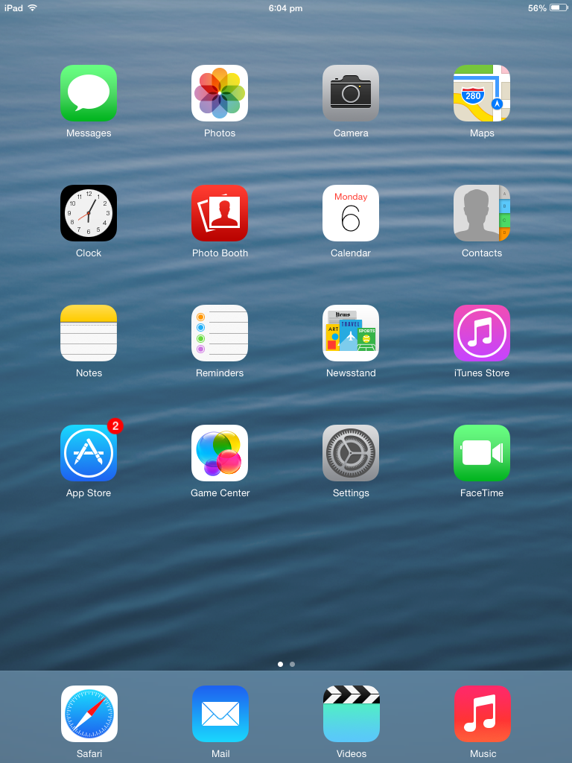
Unlock your ipad.
Find the Settings icon. Click it

Slide 3
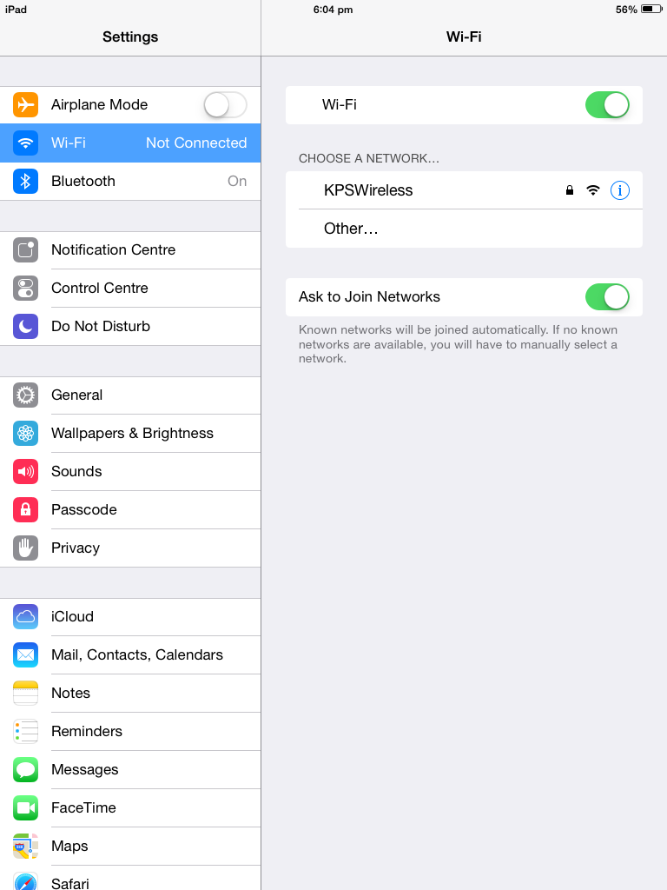
3. Ensure Wi-Fi is switched on. This is indicated by the green.
4. Select our school wireless network. It is called KPSWireless.

Slide 4
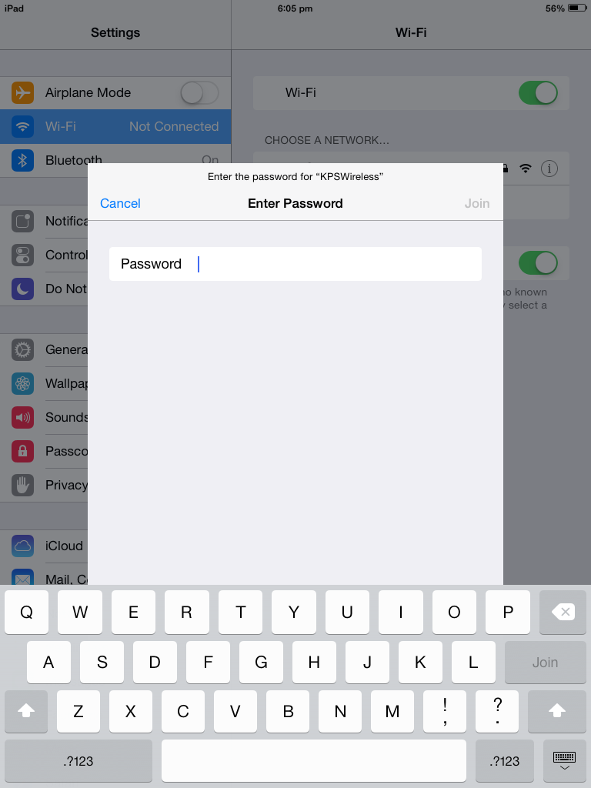
5. When prompted for the password, enter:
kpskpskpskps1
(that’s kps x4 with no capitals, then the number 1).
6. Click Join.

Slide 5
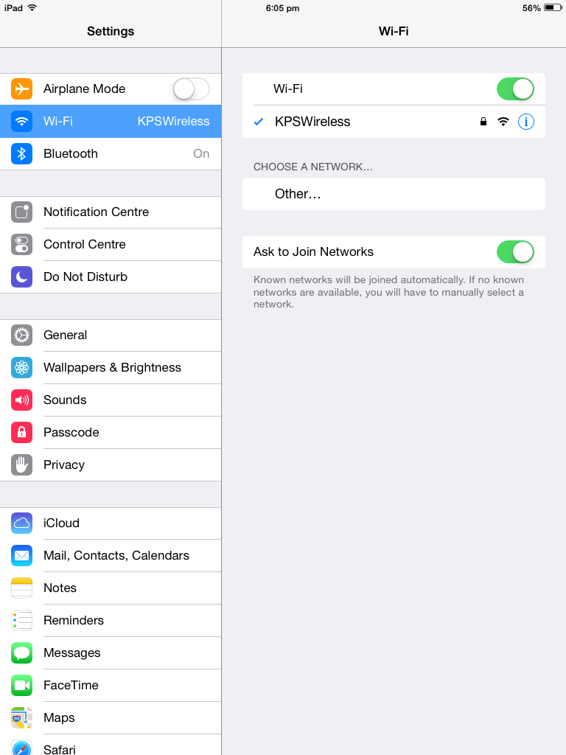
7. Initial connection has been successful if indicated by both the tick, and the wireless icon.
8. You must now click on the small blue info icon next to the wireless network indicator.

Slide 6
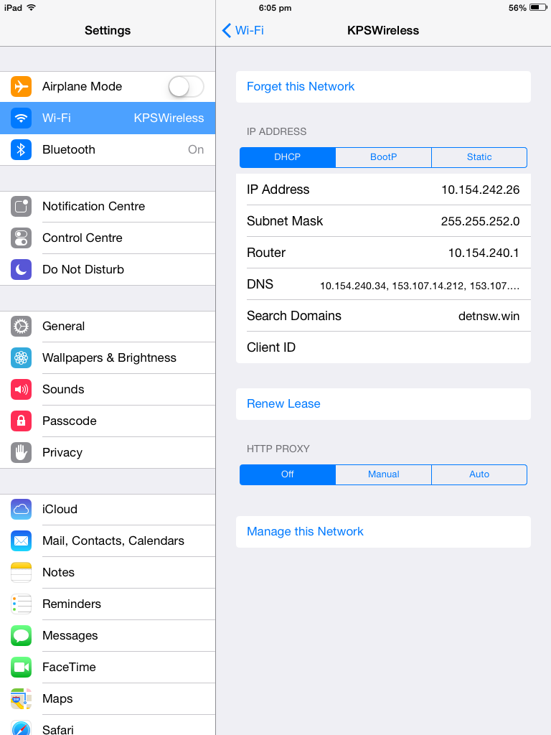
9. All of this information should ‘self assign’. That means it will appear itself. Every device will look slightly different. Its how the network names your device.
10. We have to enter special information by click the box that says ‘Manual’.

Slide 7
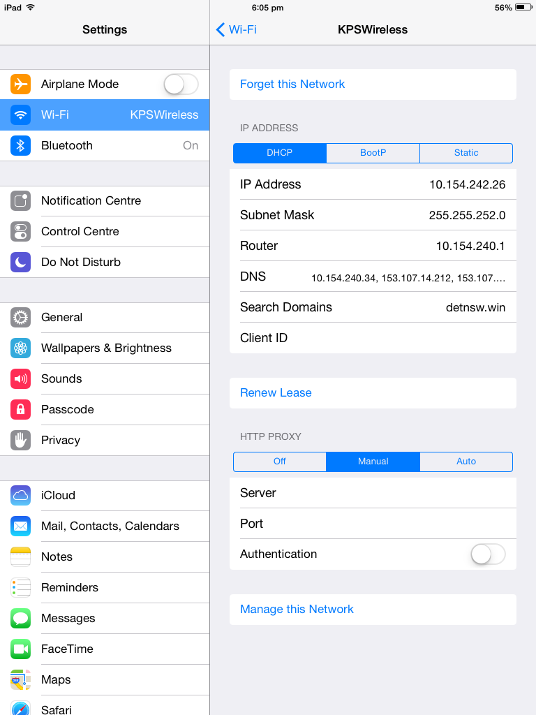
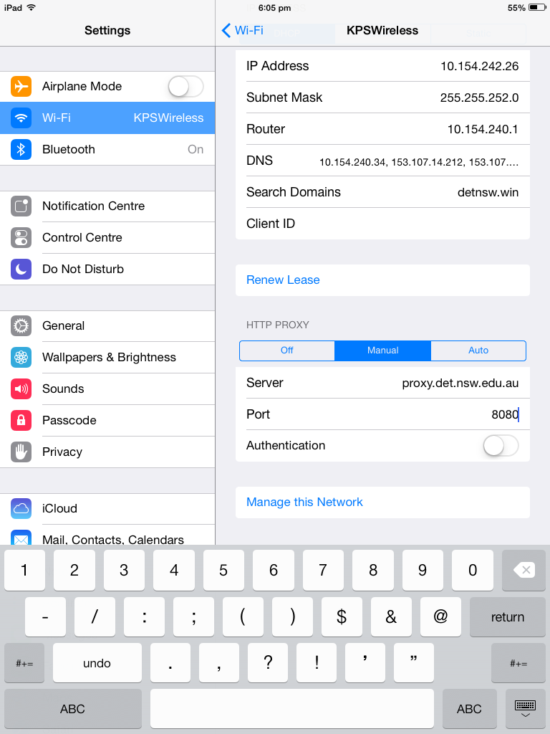
11. In the box that says ‘server’, you need to carefully write
proxy.det.nsw.edu.au
No spaces, and no capitals.
12. In the box that says port, you need to write 8080.

Slide 8
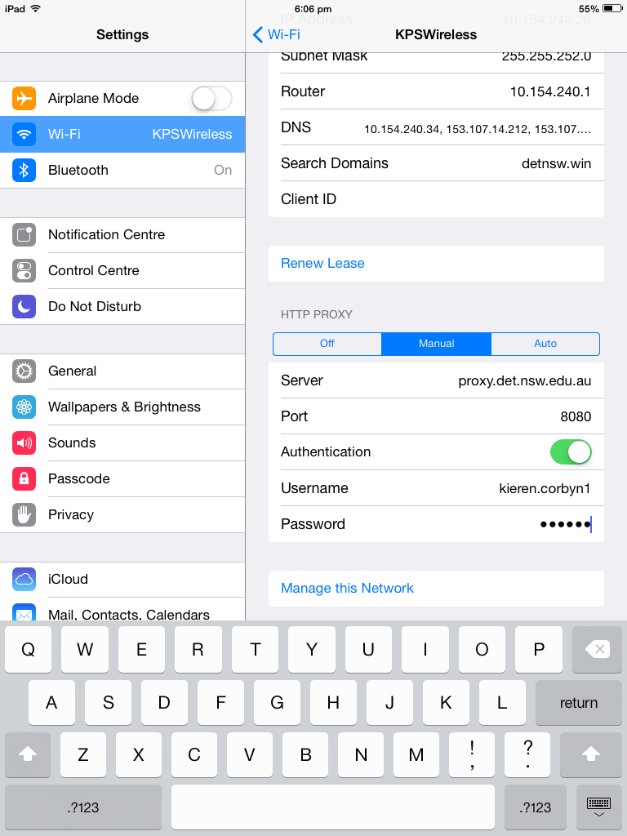
13. If you want to, you can ask the device to remember your username and password. This will make internet use quicker. To do this, slide this switch, then enter you internet username and password just as you would on a school computer to use the internet.

Slide 9
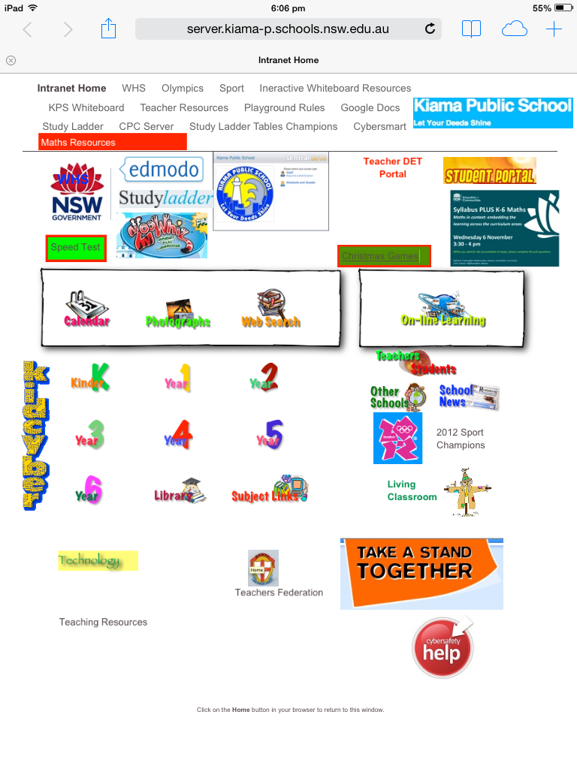
You should now have access to the internet.
Enter you username and password every time it requests it. Do not cancel it.
Too add our intranet page to your home screens:
1. Enter
server.kiama-p.schools.nsw.edu.au
Into the url bar at the top of the browser

Slide 10
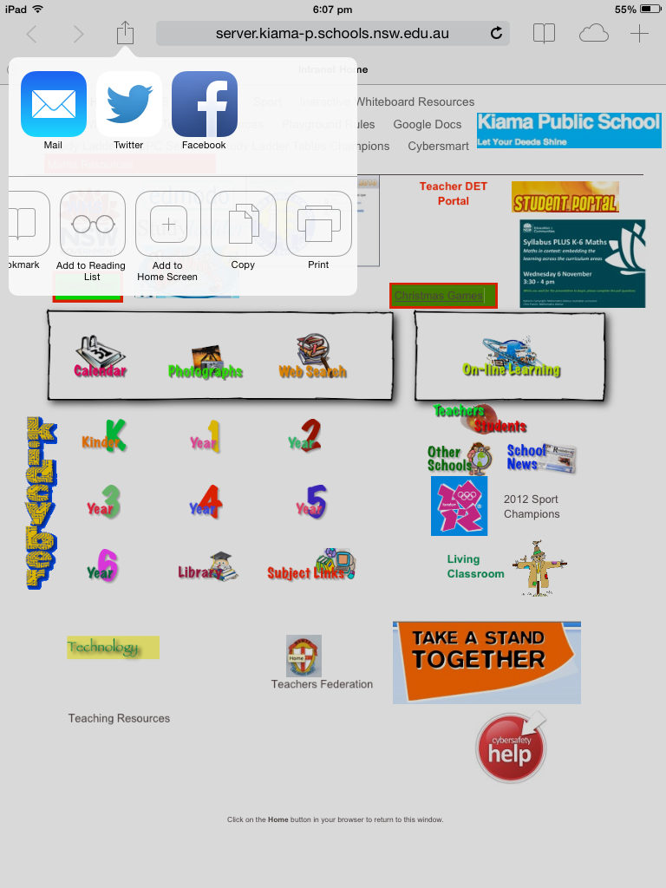
2. Then click here,
3. Then here,
4. And finally name your shortcut. KPS Portal is probably a good name.
This can only be accessed at school. It wont work at home.

Slide 11
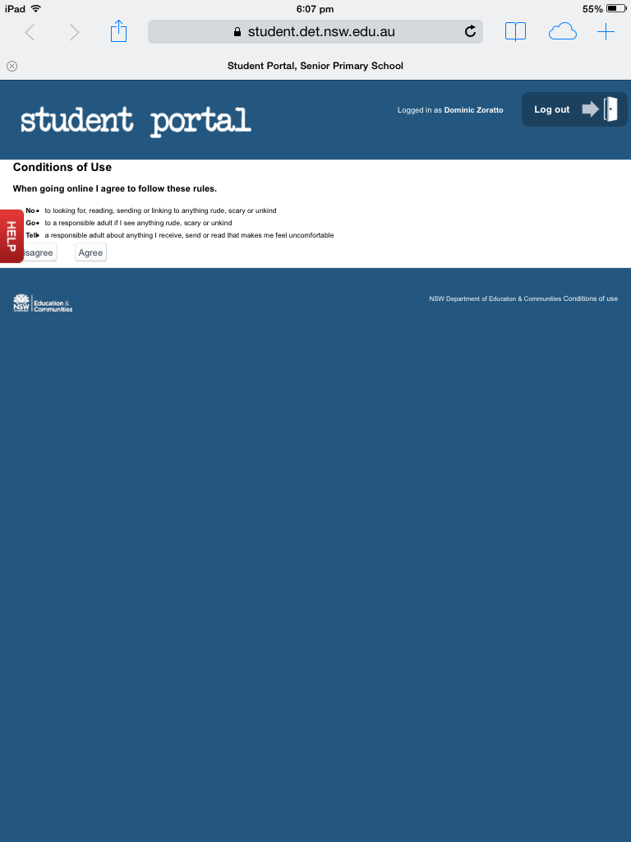
4. To put your student portal on the home screens, repeat the earlier process, but with the address
student.det.nsw.edu.au
In the url bar.

Slide 12
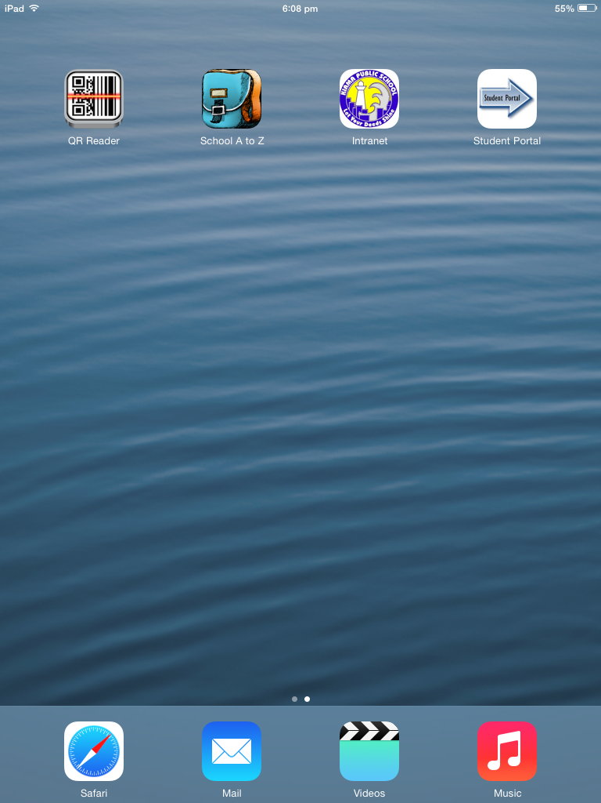
If you have done these steps correctly, you should have icons on your home screens.
I hope you enjoy using your iPads at school. If you have any questions, come and see me. Remember to always be safe, responsible and respectful when using technology in your class.
Mr Corbyn

